Slide 1

AI for Fake News Detection in Social Networks
Students:
Ivancich Stefano
Marco Zanetti
Supervisor:
Prof. Pini Maria Silvia
12 May 2021

Slide 2
Outline
The Problem
The Solution with AI
What we tried
Performance comparisons vs. other papers
Conclusions
Ivancich S. – Zanetti M.
12 May 2021
1

Slide 3
The Problem - 1
Definition: Fake news is false or misleading information presented as news. It often has the aim of damaging the reputation of a person or entity, or making money through advertising revenue.
Deep Psychological base:
“Most of the decisions that people take are not made with logic, but are made with emotions. Then the logic is used to justify the irrational choice that the individual has made.”
Fake news leverage emotions to manipulate people beliefs.
It’s not a recent year's phenomenon:
There are proof that they are being broadly used especially in politics at least since elections of Cicerone in 64 b.c. (Commentariolum Petitionis)
Probably they are going to be used in the future.
Ivancich S. - Zanetti M.
12 May 2021
2

Slide 4
The Problem - 2
Given the facts:
Fake News on Social Networks spread rapidly, with a peak in the first 2 hours.
There is a strong economical and political interest in their use. (E.g., Cambridge Analytica, Trump elections, Russian Ads,…)
Manual techniques such as debunking and fact checking websites are very slow, not applicable on a large scale, and can be easily blocked.
Social Network bubbles make people isolate themselves in their beliefs and prejudices that can be easily manipulated.
The average person doesn’t have the time, want, resources or intellectual abilities to verify the sources and study deeply a topic, they just take each statement they read as true.
highlight the need for an automatic system for detecting Fake News and hoaxes.
Ivancich S. - Zanetti M.
12 May 2021
3

Slide 5
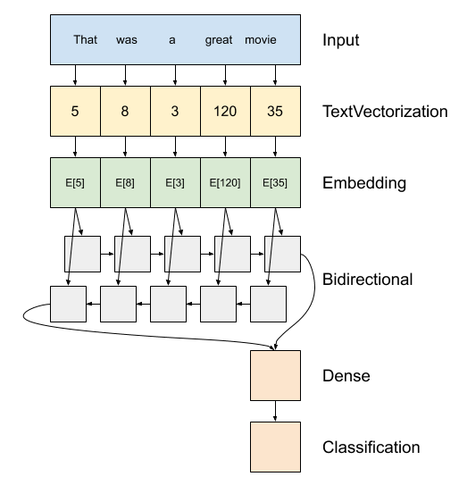
The AI Solution
G………
Ivancich S. - Zanetti M.
12 May 2021
4

Slide 6
What we tried
Datasets:
Composed of….
…..
Data Preprocessing techniques
…
….
Learning Architectures:
CNN…
RNN…
Ivancich S. - Zanetti M.
12 May 2021
5

Slide 7
The Dataset
We’ve worked with the Covid19 Fake News dataset from [Patwa et al., 2021], which contains tweets about the pandemic labelled either Real or Fake.
The dataset has been divided as follows:
A training set, used to train our models, composed of 6420 tweets;
A validation set, used to choose hyperparameters and validate our models, composed of 2140 tweets;
A test set, used to assess the performance of our models, composed of 2140 tweets.
The dataset is balanced, that is, the number of Fake news and True news it’s almost even. This is a desirable property for classification task as it makes harder for the model to solely rely on statistical properties of the data for prediction.
Ivancich S. - Zanetti M.
12 May 2021
4

Slide 8
Data pre-processing
We follow standard Natural Language Processing procedures to make the text easier to process for our models.
We convert the whole text to lowercase (e.g ‘A’ becomes ‘a’);
We remove all URL;
We remove all stopwords (e.g ‘and’, ‘or’, ‘the’);
We remove all emojis;
We lemmatize the text (e.g ‘am’, ‘are’, ‘is’ become ‘be’);
We remove punctuations (e.g ‘.’, ‘#’, ‘!’),
Ivancich S. - Zanetti M.
12 May 2021
4

Slide 9
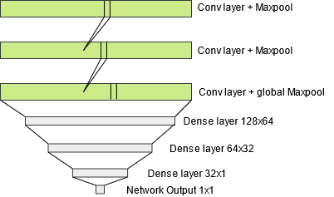
1D CNN
One-dimensional Convolutional Neural Network have been used widely in Natural Language Processing [Yoon Kim, 2014]. Text is tokenized trough an embedding layer which uses pretrained word embeddings. We deploy a network composed of 3 convolutional layers (followed by Max pooling) with kernel size of 5 and 3 Dense layers (with dropout).
Ivancich S. - Zanetti M.
12 May 2021
5

Slide 10
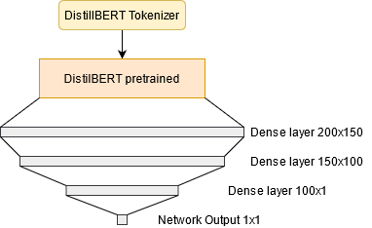
DistilBERT
We experimented with HuggingFace’s implementation of the attention model DistilBERT [Sanh et al., 2019]. DistilBERT tokenizer encode the data so that the model can process it. We imported the pretrained weights for DistilBERT and stacked 3 Dense layers with dropout on top of the model to fine-tune for our classification task.
Ivancich S. - Zanetti M.
12 May 2021
5

Slide 11
Results
 | Accuracy % | # Parameters | Speed (s)
Baseline (random guess) | 50 | / | /
1DCNN | 87.8 | 4,804,087 | 0.87
DistilBERT | 94.7 | 66,363,649 | 21.67
Ivancich S. - Zanetti M.
12 May 2021
6

Slide 12
Conclusions
Conclusions
Our models show that they can learn effectively by surpassing by a large margin baseline results;
The attention model largely outperform the simpler 1DCNN model, as is to be expected, but 1DCNN is extremely faster and less computational extensive to train.
Future Work
Try different hyperparameters during training that lead to better performance;
Implement different architectures (e.g recurrent networks);
Deploy the model to allow user to experiment with it.
Ivancich S. - Zanetti M.
12 May 2021
15

Slide 13
Connection
Ivancich S. - Zanetti M.
12 May 2021
5

Slide 14
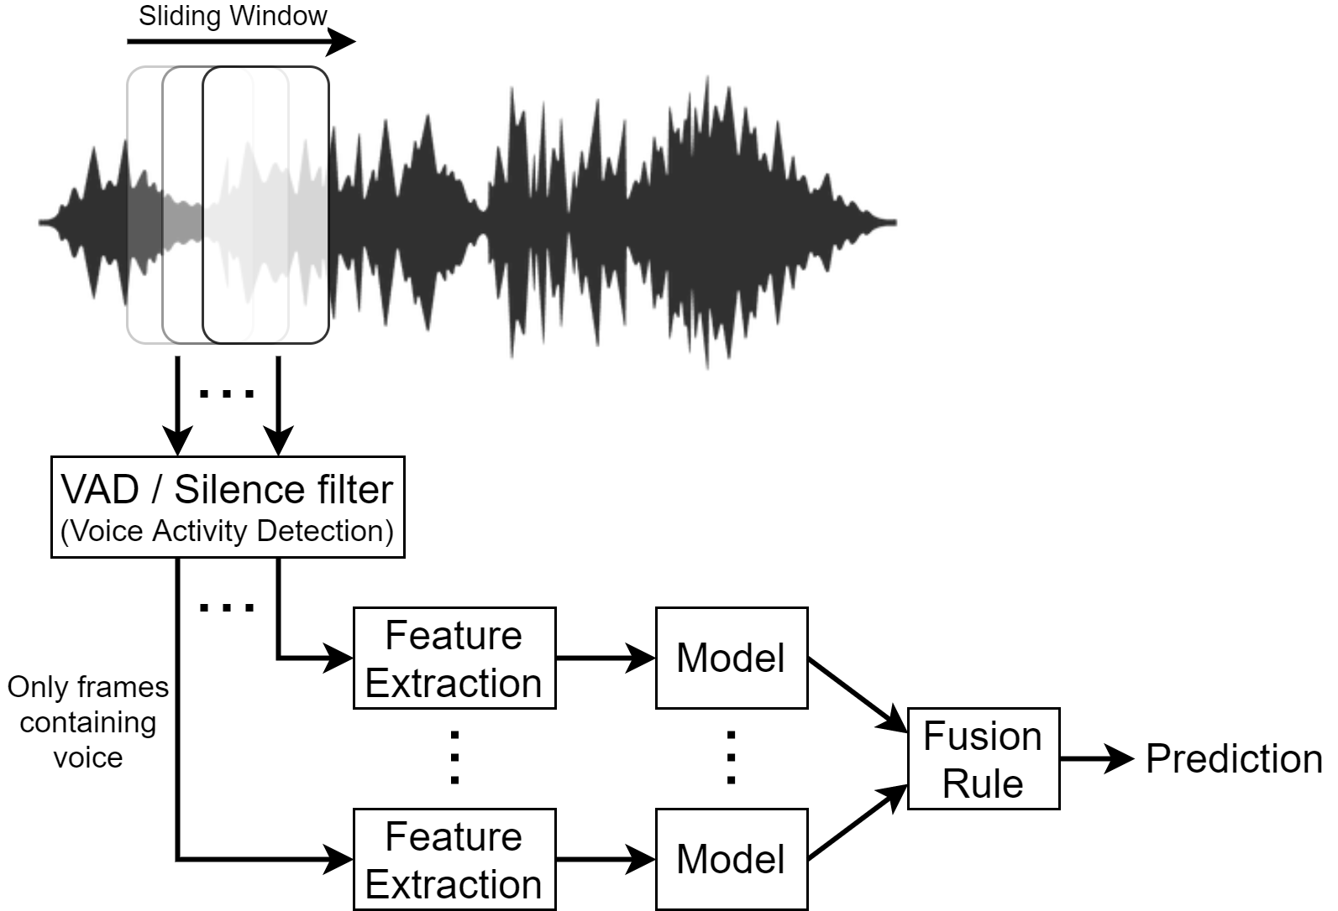
The AI Solution
Ivancich S. - Masiero L.
22 September 2020
3
Notes:
The input audio waveform X is split into S frames of 1 second.
It is to computational expensive to use the model for each frame. So we can use a VAD (Voice Activity Detection) or Silence filter to let the model process just the frames that contains voice.
This component must be very compact, low computational expensive and very fast, like just ignoring anything under 40db, it can be a piece of software or even a little piece hardware like some home device are using nowdays.
We need to aggregate the CNN predictions to come up to a decision on X.
Fusion rules can be used to reach a ﬁnal decision, such as the majority vote

Slide 15
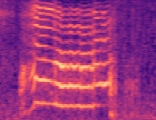
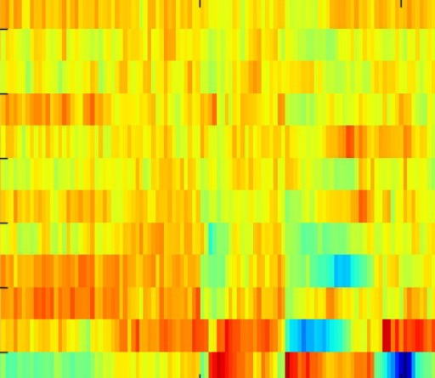
What we tried
Datasets (Google Speech Dataset V2)
10-commands (“yes”, “no”, “up”, “down”, “left”, “right”, “on”, “off”, “stop”, “go”);
21-commands ([…], “zero”, “one”, “two”, “three”, “four”, “five”, “six”, “seven”, “eight”, “nine”, unknown).
Data Preprocessing techniques
No preprocessing (Raw Waveform)
80 Mel spectrogram
40MFCC
40MFCC + 40Δ + 40Δs (=120)
Learning Architectures
1DCNN on raw data
DSConv (Small - Medium - Large)
Ensemble (Small - Medium - Large)
80 Mels
40 MFCC
Ivancich S. - Masiero L.
22 September 2020
4

Slide 16
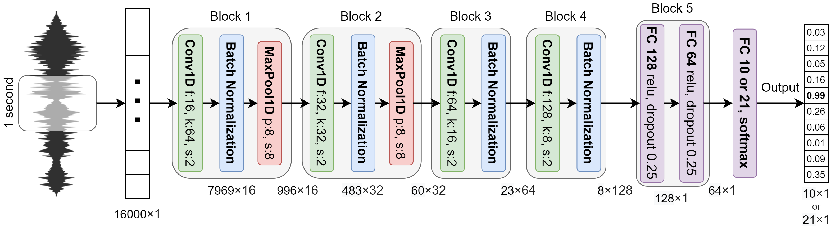
1D CNN on raw data
 | 10-commands (30K – 3K – 3K) | 21-commands (84K – 9K – 11K)
Accuracy % | 93.0 | 89.1
# parameters | 257,018 | 257,733
Speed (ms) | 28.71 | 28.25
Ivancich S. - Masiero L.
22 September 2020
5
Notes:
Input an array of 16,000 dimensions, which represents 1-second of audio sampled at 16kHz.
The architecture is composed of 4 convolutional layers, possibly interlaced with max pooling layers, followed by 2 fully connected layers and an output layer.
In order to reduce the over-fitting, batch normalization is applied after the activation function of each convolution layer.
after the last pooling layer, there are two fully connected layers with 128 and 64 neurons respectively on which a drop-out is applied with a probability of 0.25 for both layers.

Slide 17
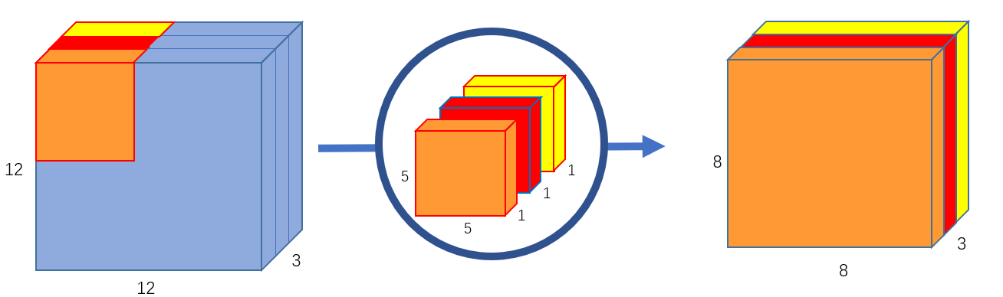
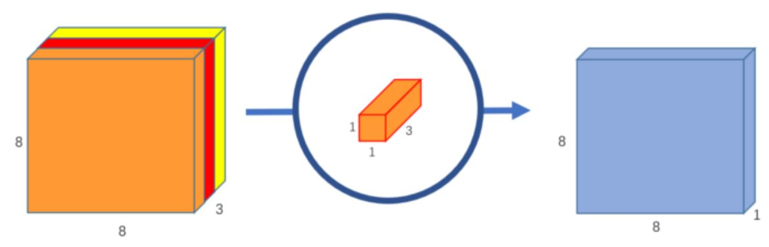
Separable Convolution
Separable convolution performs better than regular convolutional layers.
Two types of Separable convolution: Spatial and Depthwise.
Depthwise Separable convolution uses kernels that cannot be “factored” into two smaller kernels.
It splits a kernel into two separate kernels that do two convolutions:
the depthwise convolution;
the pointwise (1x1) convolution.
Ivancich S. - Masiero L.
22 September 2020
6

Slide 18
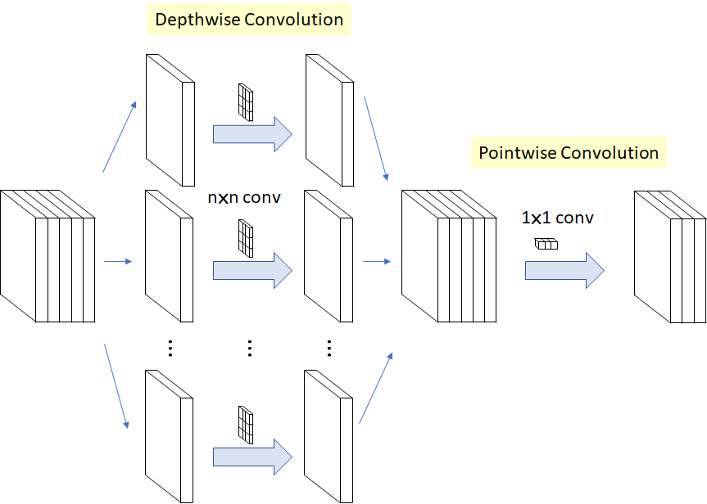
Depthwise Separable Convolution
1 Filter Normal Convolution
Depthwise Convolution = 1 K×K×1 filter for each convolution
VS
Saparable Depthwise Convolution
Ivancich S. - Masiero L.
22 September 2020
7

Slide 19
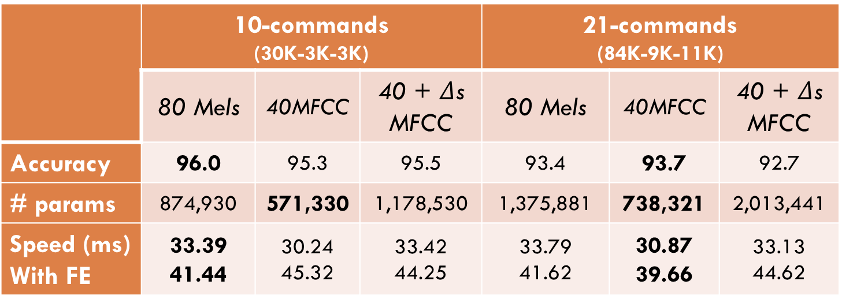
DSConv Model - Large
 | 10-commands (30K-3K-3K) |  |  | 21-commands (84K-9K-11K)
 | 80 Mels | 40MFCC | 40 + $Δ$s MFCC | 80 Mels | 40MFCC | 40 + $Δ$s MFCC
Accuracy | 96.0 | 95.3 | 95.5 | 93.4 | 93.7 | 92.7
# params | 874,930 | 571,330 | 1,178,530 | 1,375,881 | 738,321 | 2,013,441
Speed (ms) With FE | 33.39 41.44 | 30.24 45.32 | 33.42 44.25 | 33.79 41.62 | 30.87 39.66 | 33.13 44.62
Ivancich S. - Masiero L.
22 September 2020
8

Slide 20
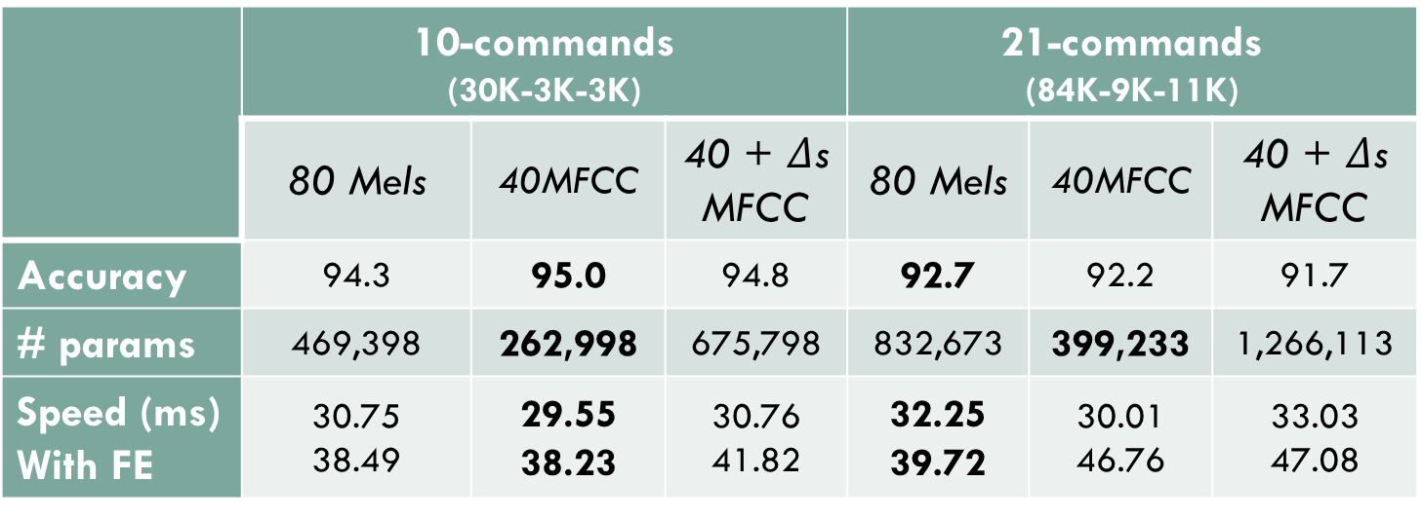
DSConv Model - Medium
 | 10-commands (30K-3K-3K) |  |  | 21-commands (84K-9K-11K)
 | 80 Mels | 40MFCC | 40 + $Δ$s MFCC | 80 Mels | 40MFCC | 40 + $Δ$s MFCC
Accuracy | 94.3 | 95.0 | 94.8 | 92.7 | 92.2 | 91.7
# params | 469,398 | 262,998 | 675,798 | 832,673 | 399,233 | 1,266,113
Speed (ms) With FE | 30.75 38.49 | 29.55 38.23 | 30.76 41.82 | 32.25 39.72 | 30.01 46.76 | 33.03 47.08
Ivancich S. - Masiero L.
22 September 2020
9

Slide 21
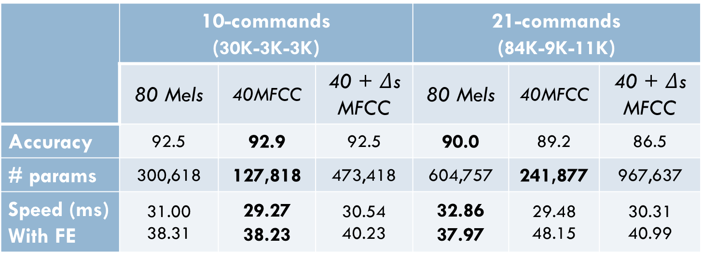
DSConv Model - Small
 | 10-commands (30K-3K-3K) |  |  | 21-commands (84K-9K-11K)
 | 80 Mels | 40MFCC | 40 + $Δ$s MFCC | 80 Mels | 40MFCC | 40 + $Δ$s MFCC
Accuracy | 92.5 | 92.9 | 92.5 | 90.0 | 89.2 | 86.5
# params | 300,618 | 127,818 | 473,418 | 604,757 | 241,877 | 967,637
Speed (ms) With FE | 31.00 38.31 | 29.27 38.23 | 30.54 40.23 | 32.86 37.97 | 29.48 48.15 | 30.31 40.99
Ivancich S. - Masiero L.
22 September 2020
10

Slide 22
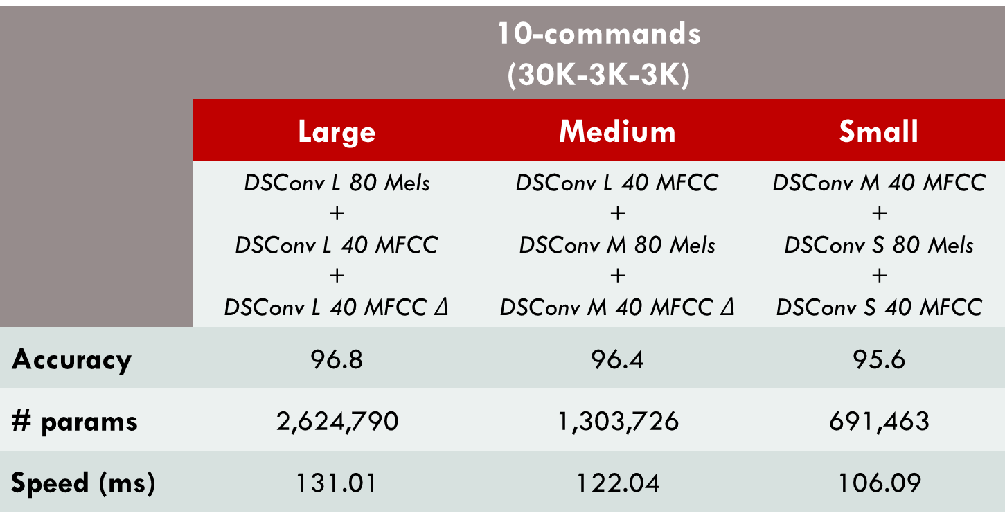
Ensemble: 10-commands
Ensemble between the best models.
 | 10-commands (30K-3K-3K)
 | Large | Medium | Small
 | DSConv L 80 Mels + DSConv L 40 MFCC + DSConv L 40 MFCC $Δ$ | DSConv L 40 MFCC + DSConv M 80 Mels + DSConv M 40 MFCC $Δ$ | DSConv M 40 MFCC + DSConv S 80 Mels + DSConv S 40 MFCC
Accuracy | 96.8 | 96.4 | 95.6
# params | 2,624,790 | 1,303,726 | 691,463
Speed (ms) | 131.01 | 122.04 | 106.09
Ivancich S. - Masiero L.
22 September 2020
11

Slide 23
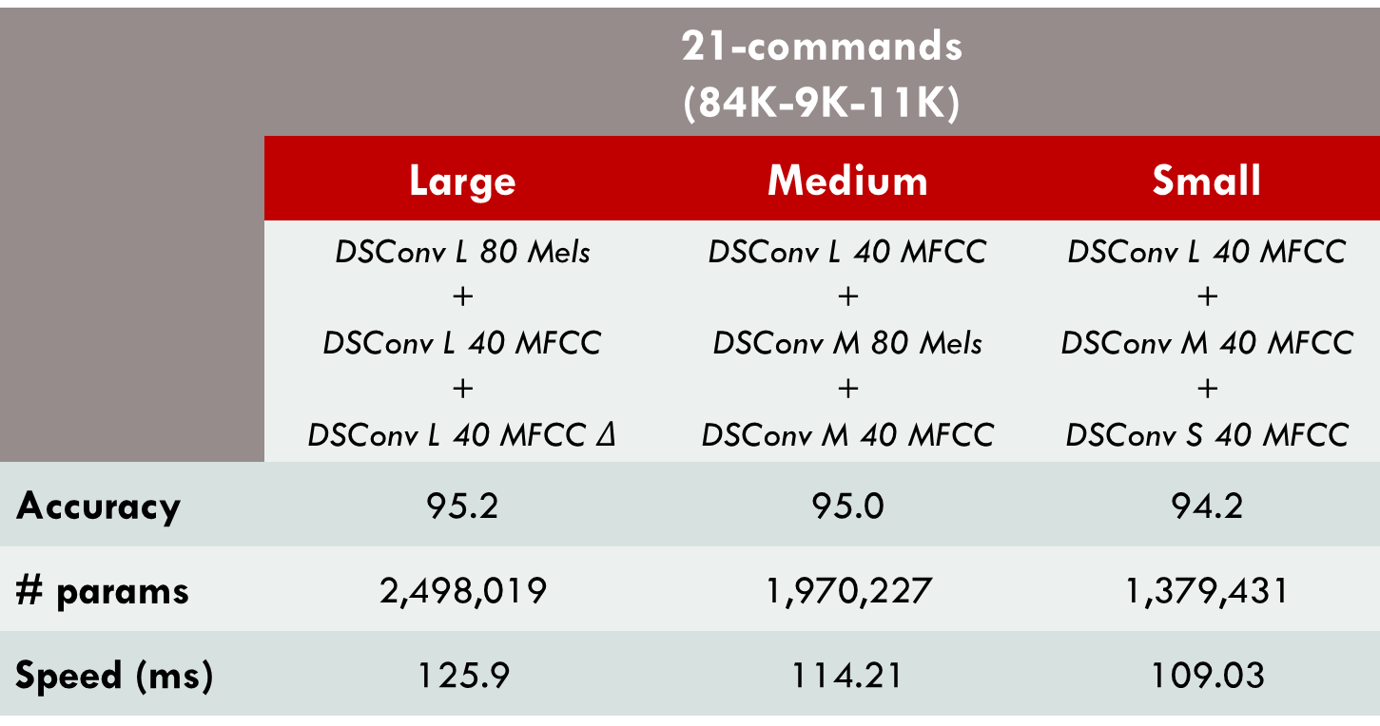
Ensemble: 21-commands
Ensemble between the best models.
 | 21-commands (84K-9K-11K)
 | Large | Medium | Small
 | DSConv L 80 Mels + DSConv L 40 MFCC + DSConv L 40 MFCC $Δ$ | DSConv L 40 MFCC + DSConv M 80 Mels + DSConv M 40 MFCC | DSConv L 40 MFCC + DSConv M 40 MFCC + DSConv S 40 MFCC
Accuracy | 95.2 | 95.0 | 94.2
# params | 2,498,019 | 1,970,227 | 1,379,431
Speed (ms) | 125.9 | 114.21 | 109.03
Ivancich S. - Masiero L.
22 September 2020
12

Slide 24
Performances: 10-commands
 | Accuracy % | # Parameters | Speed (ms)
SincConv [Mittermaier et al.] | 97.4 | 162K | 40.35
Our Ensemble Large | 96.8 | 2,624,790 | 131.01
Our Ensemble Medium | 96.4 | 1,303,726 | 122.04
Our DSConvLarge + 80Mels | 96.0 | 874,930 | 41,44
Our Ensemble Small | 95.6 | 691,463 | 106.09
Our DSConvMedium + 40MFCC | 95.0 | 262,998 | 38,23
Our 1DCNN on raw data | 93,0 | 257,018 | 28,71
Our DSConvSmall + 40MFCC | 92,9 | 127,818 | 38,23
Best: Ensemble Large
Smaller: DSConvSmall + 40MFCC
Fastest: 1DCNN on raw data
Ivancich S. - Masiero L.
22 September 2020
13

Slide 25
Performances: 21-commands
 | Accuracy % | # Parameters | Speed (ms)
SincConv [Mittermaier et al.] | 97.4 | 162K | 40.35
Our Ensemble Large | 95.2 | 2,498,019 | 125.9
Our Ensemble Medium | 95.0 | 1,970,227 | 114.21
Our Ensemble Small | 94.2 | 1,379,431 | 109.03
Our DSConvLarge + 40MFCC | 93.7 | 738,321 | 39.66
Our DSConvMedium + 80Mels | 92,7 | 832,673 | 39,72
Our DSConvSmall + 80Mels | 90,0 | 604,757 | 37,97
Our 1DCNN on raw data | 89,1 | 257,733 | 28,25
Best: Ensemble Large
Smaller: 1DCNN on raw data
Fastest: 1DCNN on raw data
Ivancich S. - Masiero L.
22 September 2020
14

Slide 26
Conclusions
Conclusions
Tests: our models are very good at classifying keywords;
We did not beat the state-of-the-art models;
We found that the number of convolutional layers played a key role in detecting high-level concepts;
No difference between 80 Mels or 40 MFCCs;
Different model sizes in order to fit different devices.
Future Work
Try different hyperparameters during training;
Change the structure of the network using:
SincConv;
GDSConv.
Ivancich S. - Masiero L.
22 September 2020
15

Slide 27
How we have tackled it
1) Literature from:
Teacher’s material
ArchiveX
paperswithcode.com
Reddit
GitHub
Paper’s references
2) For each paper:
What we find useful for our problem?
Which references we want to follow?
1D CNN
Attention
40 MFCC
DSConv
…
Ivancich S. - Masiero L.
20 July 2020
3

Slide 28

How we have tackled it
3) Try to mix from things written down
Example:
Paper X says that MFCC are good for human voice …
Paper Y says that DSConv are faster than normal CNN …
Mixing X and Y will work?
4 ) Debugging:
Bias vs Variance
Error Analysis: look at the misclassified examples
Why didn’t work? When explaining we discovered other things to try
40 MFCC
DSConv
Ivancich S. - Masiero L.
20 July 2020
4

